Slide 2
TAKE CARE WITH AI ADOPTION!
Data Privacy in GenAI
Data Security in GenAI
Intellectual Property Protection
Current models don’t have “forgetting” feature for personal data.
Models are treained on large amounts of data which may include personal information. This might violate a person’s privacy rights.
GenAI models have potential to memorize and reproduce training data.
What if training includes sensitive or confidential data?
GenAI models might be trained on proprietary or copyrighted data.
Arrange legal agreements to protect intellectual property and ensure the output of the models is used appropriately.
Legal Issues
Ethical Issues
Social / Environment Issues

Slide 3
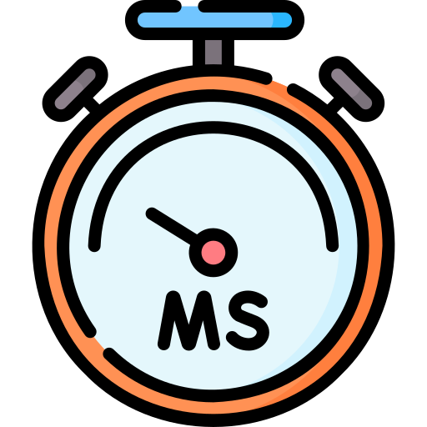
CHOOSE RIGHT MODEL FLAVOR
Privacy
Quality
Cost
Latency

Slide 4
EU DIGITAL SERVICES AND DATA INITIATIVES
EU DIGITAL SERVICES PACKAGE
Online intermediaries are, in principle, not liable for content hosted or transmitted
But they have to act expeditiously to remove any flagged illegal content
Imposes obligations (including data and interoperability rules) on ‘gatekeeper’ platforms
Gatekeepers are providers of core platform services that meet certain financial and user thresholds
EU Digital Services Act
EU Digital Markets Act
EU DATA STRATEGY AND ARTIFICIAL INTELLIGENCE STRATEGY
Establishes a governing framework for data sharing and uses in the EU
Regulates the re-use of public data, data intermediation services and data altruism activities
Applies to manufacturers of smart devices and cloud services providers
IoT products have to allow users to easily and in real time access data collected or generated
Covers providers, manufacturers, users, distributors and importers of AI systems
Bans certain AI systems and requires a conformity assessment with respect to high-risk AI systems
EU Data Governance Act
EU Data Act
EU Artificial Intelligence Act

Slide 5
EU DIGITAL SERVICES AND DATA INITIATIVES
October 2022
April 2023
June 2023
August 2023
February 2024
EU Digital Markets Act
DMA enters into force
DMA becomes applicable
Deadline for affected companies to submit ‘gatekeeper’ notifications
Commission designates companies as gatekeepers
Gatekeepers have to comply with the obligations set out in the DMA
July 2022
September 2022
October 2022
Q1 2024
EU Digital Services Act
EP formally approved DSA
Expected formal approval by Council / adoption of DSA
Earliest expected entry into force
Providers have to comply with DSA obligations
Exc.: VLOP and VLOS

Slide 6
EU DIGITAL SERVICES AND DATA INITIATIVES
November 2020
November 2021
June 2022
September 2023
September 2025
EU Digital Markets Act
Proposal for DGA published by European Commission
Political agreement reached by European Parliament and Council of the EU
The DGA entered into force
The DGA becomes applicable
Data Intermediation Services must comply
April 2021
April 2022
Second Semester 2022
2023
Data Governance Act
Commission published proposal for an EU regulatory framework on artificial intelligence – the AIA
EU Parliament issued proposed amendments to AIA
Ongoing discussions in EU Parliament and EU Council
Anticipated Approval of AIA

Slide 7
DATA GOVERNANCE
EU Data Governance Act
Aim: Enabling “more data and good quality data” to fuel innovation.
Main purpose: Provides a framework to ensure that data can be shared with confidence and be technically easy to re-use.
Sectors mainly impacted: Impacts a range of sectors, including health, environment, energy, agriculture, mobility, finance, manufacturing and public administration.
Governance and Enforcement: National competent authorities and European Data Innovation Board.
Practical impact: Fosters the availability of data for use by increasing trust in data intermediaries and strengthening data-sharing mechanisms across the EU.
Extraterritorial scope: DGA will apply to data intermediaries providing services into the EU and data altruism organisations that are collecting data from within the EU.

Slide 8
AI
EU Data Act
Aim: To (i) ensure AI systems placed on the EU market are safe and respect existing law, (ii) ensure legal certainty to facilitate investment and innovation in AI, (iii) enhance governance and effective enforcement; and (iv) facilitate the development of a single market for lawful, safe and trustworthy AI.
Main purpose(s): To create harmonised rules for the development, placing on the market, and use of AI in the EU.
Sectors mainly impacted: All sectors.
Governance and Enforcement: European AI Board and National Competent Authorities (NCAs). Maximum fines of 6% annual worldwide turnover or €30 m (i.e., higher than GDPR)
Practical impact: Applies primarily to providers (i.e., the entity that develops or has an AI system developed) and users of AI systems. AIA seeks to regulate AI systems in accordance with the level of risk they present.
Extraterritorial scope: Applies primarily to: (i) Providers of AI systems placing AI systems on the EU market (irrespective of location of provider), (ii) Users of AI systems located in the EU, and (iii) Providers and users of AI systems located in third country where the output of those systems are used in the EU.

